Slide 1
CYSA Travel Coaches Meeting

Slide 2
CYSA Philosophy

Slide 3
Why Do Kids Play Sports?
Because it is fun!
What makes it fun?
Trying your best
When the coach treats a player with respect
Getting playing time
Playing well as a team
Getting along with teammates
Being active
Further down the list:
48. Winning
63. Tournaments
66. Training
Visek, Amanda et al, “The Fun Integration Theory Towards Sustaining Children and Adolescents Sport Participation,” Journal of Physical Activity and Health, March 2015

Slide 4
Coaches
Kids are NOT likely to remember what you said and they are not likely to remember what you did but they will always remember how you made them feel.

Slide 5
Coaches
Lead by Example:
The team will reflect your individual personality traits. If you are calm, the team will be calm. If you are positive, the players will be as well.
If you are negative or reactionary, the team will act similarly. Be aware of your influence.

Slide 6
Training & Games
Training
No Lines, No Laps and No Lectures
Keep things moving - the more touches the better
Kids should have a ball at their feet for ALL activities (even warm ups)
Make it fun and competitive
Games
Equal Playing time (minimum 40%)
Rotate positions
Do not have keepers play the entire game
Player development over winning

Slide 7
Flexibility
CYSA’s Goal 🡪 Kids to Love Soccer & to want to play the game for life
Reality 🡪 Kids play multiple sports & have crazy schedules
Coaches need to be flexible & understanding
Desire 🡪 all kids attend every practice
Reality 🡪 attend at least 1 practice per week
Work with other coaches to allow and encourage training with other teams when conflicts arise

Slide 8
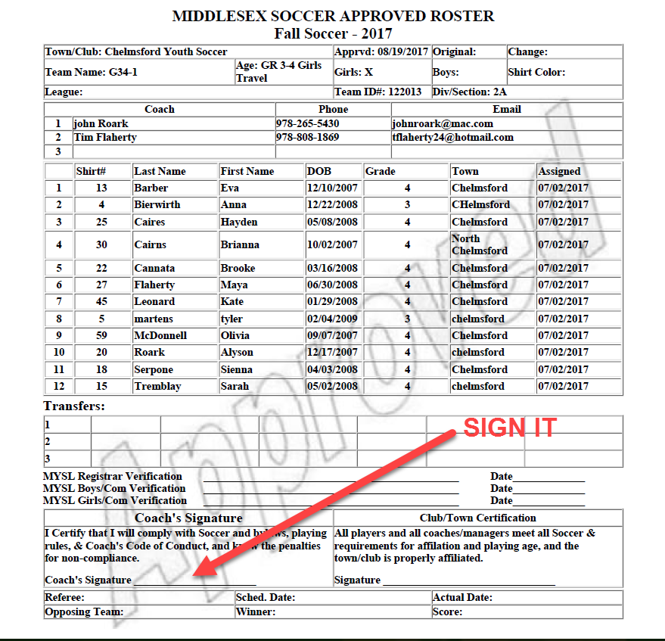
MYSL Roster
Have two SIGNED copies of your roster to give to the ref at the start of each game
Suggestion – make 25 copies now, fold and put in a gallon Zip-lock bag (waterproof) in your equipment bag

Slide 9
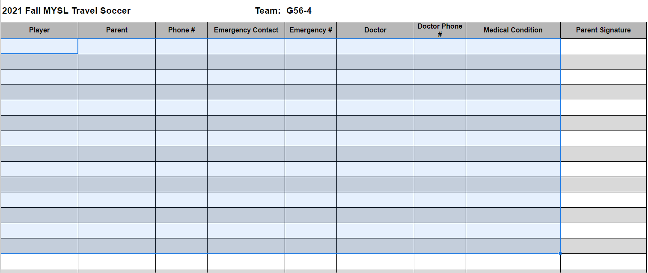
Medical Roster
Will be emailed to you by Travel Director
Print out and keep with you, no need for parents to sign
Pay attention to any Medical Conditions

Slide 10
MYSL
MYSL Home Page
Divisions and Laws
5 divisions with D1 being the highest
Each division has up to 4 sections (A to D)
All sections in a division are the SAME
Sections created due to QUANTITY of teams ONLY
MYSL Age Directors
Your key contact to the MYSL league
Age Director is based on age, gender & division
Click here for MYSL names and contact info under Board/Management

Slide 11
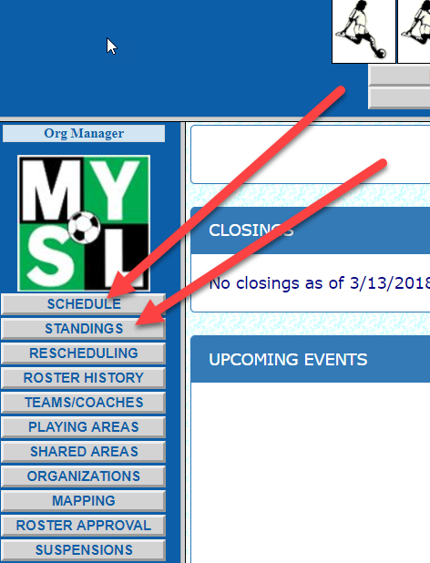
Navigating MYSL
MYSL Website
Schedule and Standings link on left menu
Schedule Page
Use filters to find your team
Click View Schedule after filtering
Click ? To get coach contact info and field directions/address
Standings Page
Use filters to find your team
Position in Division
Head to Head Scores

Slide 12
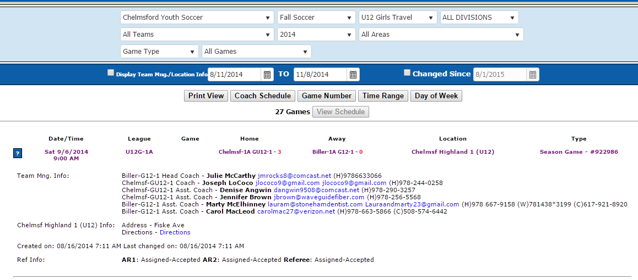
Navigating MYSL
MYSL – Schedule Page

Slide 13
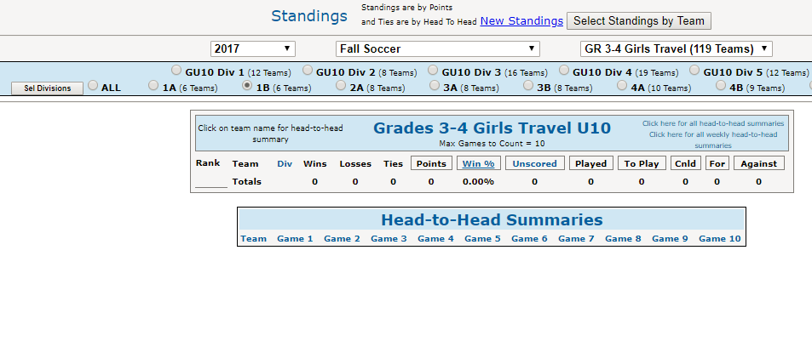
Navigating MYSL
MYSL – Standing Page

Slide 14
Travel General Info.
Grade 3&4 plays 7 v 7
Grade 5&6 plays 9 v 9
No heading until you get to Grade 7&8
Off sides at every level in travel
Note: Grade 3&4 will only have Center Refs

Slide 15
Game Cancellations
How:
Fields are closed by CYSA (by 8 AM) – check website
If fields are declared open in the morning and the weather or fields are an issue later in the day, the Referee is the only authorized person to cancel the game – this is determined at the time of the game – teams must go to the field for a decision.
Games CAN NOT be cancelled by an agreement between the two coaches

Slide 16
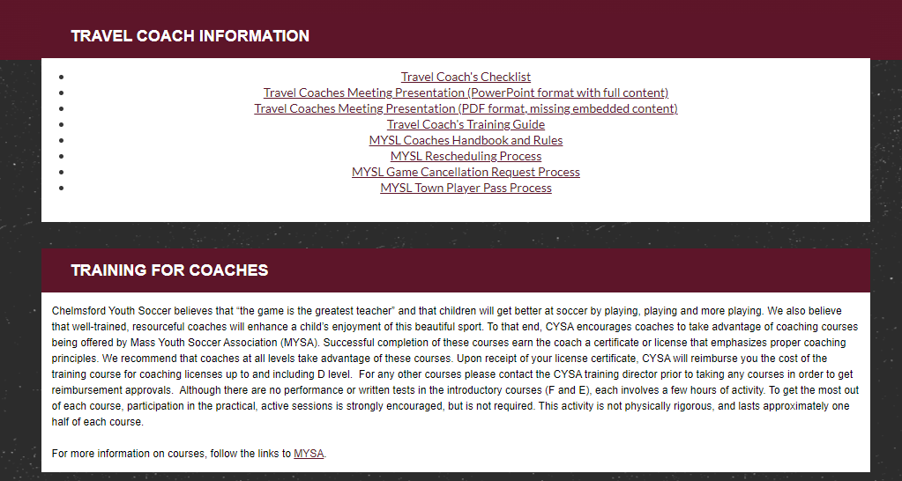
Resources
CYSA Website
Under Resources / Coaches

Slide 17
Resources
CYSA Website
Under Resources / Training

Slide 18
Unique Rules – Grade 3&4
Goal Kicks
Opposition players to retreat into their own half of the playing field on goal kicks. US Youth Soccer recommends that opponents should remain in their own half until the ball is in play. The team taking the goal kick does not have to wait for the opposition to retreat and has the option to restart the game beforehand should they so choose. The ball is in play when it is kicked directly out of the penalty area.
Punts
Keeper distributions (punts, drop kicks and throws) may not travel in the air over the halfway line. An Indirect free kick from midfield is awarded to the other team if this happens.

Slide 19
Travel Coach Shirts
Coaches new to Travel get a shirt
Visit Center Sports to be sized
Provide Drew your Name
Pick up when Drew specifies
Paid for by CYSA

Slide 20
Referee Notes
Subbing from centerline only
Coaches and players must be at least 10 yards from the midline, other than players being subbed
Keep coaches, players & parents a minimum of 3ft from the touch line (opposite sideline of players)
Tell players to ALWAYS bring both shirts
Coaches – bring pinnies just in case players forget to bring both shirts
Home team is responsible for resolving uniform color issues

Slide 21
Referees & Parents
Referees:
Coaches should not be addressing the referee during a game
If there is an issue, discuss it at halftime (calmly - it should only be about safety or clarification on a rule)
There is a zero tolerance policy with respect to any referee abuse (verbal or otherwise)
The referee is given the benefit of the doubt – not the coach
Parents:
Encourage parents to cheer, but not coach from the side line
Address any issues right away

Slide 22
CYSA Fields
Fall 2022 Field Use:
Grade 7&8: CHS Stadium (games only), Murphy & Harrington for training and overflow games
Grade 5&6: South Row and Harrington
Grade 3&4: South Row and Highland
Check CYSA Web Site>Fields for field layouts and numbering to make sure you are on the correct field for practices and games.

Slide 23
CYSA Fields – PLEASE NOTE
Highland Field
Home games at Highland
Reach out to the visiting coach & advise them of the limited parking & ask their parents to not block driveways or park on people’s lawns
ALL Fields – General Use – Keep our fields great
Warm up off the main field areas
Change field locations used for training
Limit use in goal and central field areas
Use empty off field grass spaces when possible

Slide 24
Schedule
CYSA Training Schedule
Training schedule provided by Patti Goodwin
All coaches should have their training schedule now
Training once fields are open - Sept 6th
MYSL Game Schedule (Game 1 – 9/10/2022)
Schedules should be release Sept 4th or 5th
9 Game Season
Makeup Games
Weeknights and Sundays for all age groups since it is all managed by CYSA
See Appendix for details on ODD # of Teams in your Bracket

Slide 25
Equipment Notes
Ice Packs in all containers – combo – 1225
Check your equipment as soon as possible
Any issues or requests throughout the season email the equipment manager at: equipment@chelmsfordyouthsoccer.com
If you notice anything needed with equipment containers at fields (broken lock, missing/broken corner flags, no ice packs, etc.) please notify CYSA.

Slide 26
MYSL Player Pass Process
Please read – MYSL player pass process, pages 20 to 23
Please see Appendix page 40 & 41 with more details and steps on how to create and account and to use the online process
Highlights & Key Points - Start process early in week
Player’s own team takes priority
Player MUST play both games (both coach and player say OK)
Why Play Up? 🡪 not enough players or reward and opportunity
ONLY PLAY FOR 1 OTHER TEAM (2 GAMES MAX ON SATURDAY)

Slide 27
MYSL Rescheduling Process
Managed by the Home Team Coach.
Email the away coach and suggest three dates/times. Use your practice nights.
Makeup games take priority over all practices for field use
Agree on a date/time with the away coach
For all age groups:
Email CYSA Field Assignor, Patti Goodwin (field_assignor@chelmsfordyouthsoccer.com)
Email CYSA Referee Director, Kayode Michael Arimoro (referees@chelmsfordyouthsoccer.com)
They both must approve the request (field and referee availability)
Email correct Age Director from MYSL about the rescheduling of the game. Contact info for your particular Age Director found on MYSL page and under Board/Management
Once approved by the CYSA Field Assignor and the Referee Assignor/Director – use the MYSL process email with link (sent only to the home team head coach)

Slide 28
CORI
CORI Requirements
Did you take your CORI Lanyard?
Lanyards MUST be worn at ALL games
No Lanyard 🡪 No Sideline
No Coaches with Lanyards 🡪 No Game (forfeit by violators)
Coaches notify referee of any situation
Referees will record situation as part of their report
For training, lanyards must be with you and available
Any questions contact the Cori Administrator: CoriAdmin@chelmsfordyouthsoccer.com
Pickup for CORI ID/Lanyard will be scheduled by Cori Admin

Slide 29
Passcards - Coach
Required for every game
Coaches need them for all age groups
Ref may check passcard for each coach
Travel Director will distribute prior to season start

Slide 30
Sportsmanship
Keep Game scoring under Control (Good Sportsmanship)
If you are winning by 6 goals make changes to prevent a blowout
Remove a player - play one down (or 2 if needed)
Play ball control/keep away. Great opportunity to move the ball from side to side and back versus just forward. (including using the keeper)
Tell players to only shoot with their weak foot.
Play kids in positions that they normally do not play, development opportunity.
Winning by double digits risks the league calling for disciplinary action

Slide 31
Challenger Coaching - Training
Training Plans: (Dylan will support travel)
Focus will be on newer coaches and younger age groups
Schedules provided shortly
Experienced coaches who want a session – email a request ASAP
CYSA Coach Expectations for Training:
A few days before your training session reach out to the coach about your training needs
During the Training – stay engaged – coach with the coach
Treat this as an opportunity for both you and your team

Slide 32
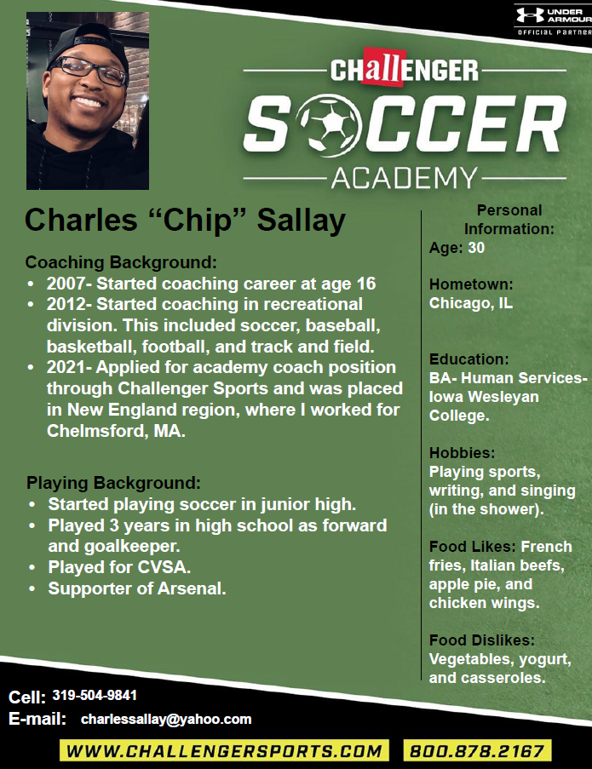
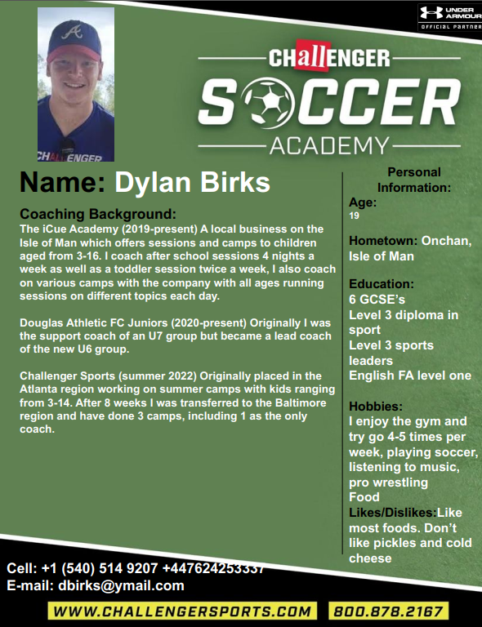
Challenger Coaches

Slide 33
In Season – CYSA Requests
Player Evaluations
Process starts - halfway through season
Template, instructions and sample provided
Submit before the end of season
Critical part of coaching – helps with placement
Group effort – all coach’s contribute to a single team evaluation

Slide 34
Playoffs – Spring Only
Commissioner’s Cup (CC)
June
Top 4 teams from each division(not section) make playoffs
Location – Lancaster
Grade 5&6 and older 🡪 D1 and D2 – single game elimination
All Grade 3&4 – round robin – 3 games
Grade 5&6 and older D3, D4 and D5 – round robin – 3 games
Massachusetts Tournament of Champions (MTOC)
June
ONLY D1 and D2 winners from all leagues in Massachusetts
Location – Lancaster
Round Robin then semi-finals and finals (like World Cup)

Slide 35
Travel Assessments
May @ Harrington
Do Not schedule or accept makeup games this week
Team training will be limited since players will be doing assessments
Your team can be impacted by the current age assessment dates and the next grade up dates
Assessments take priority over all other team activities

Slide 36
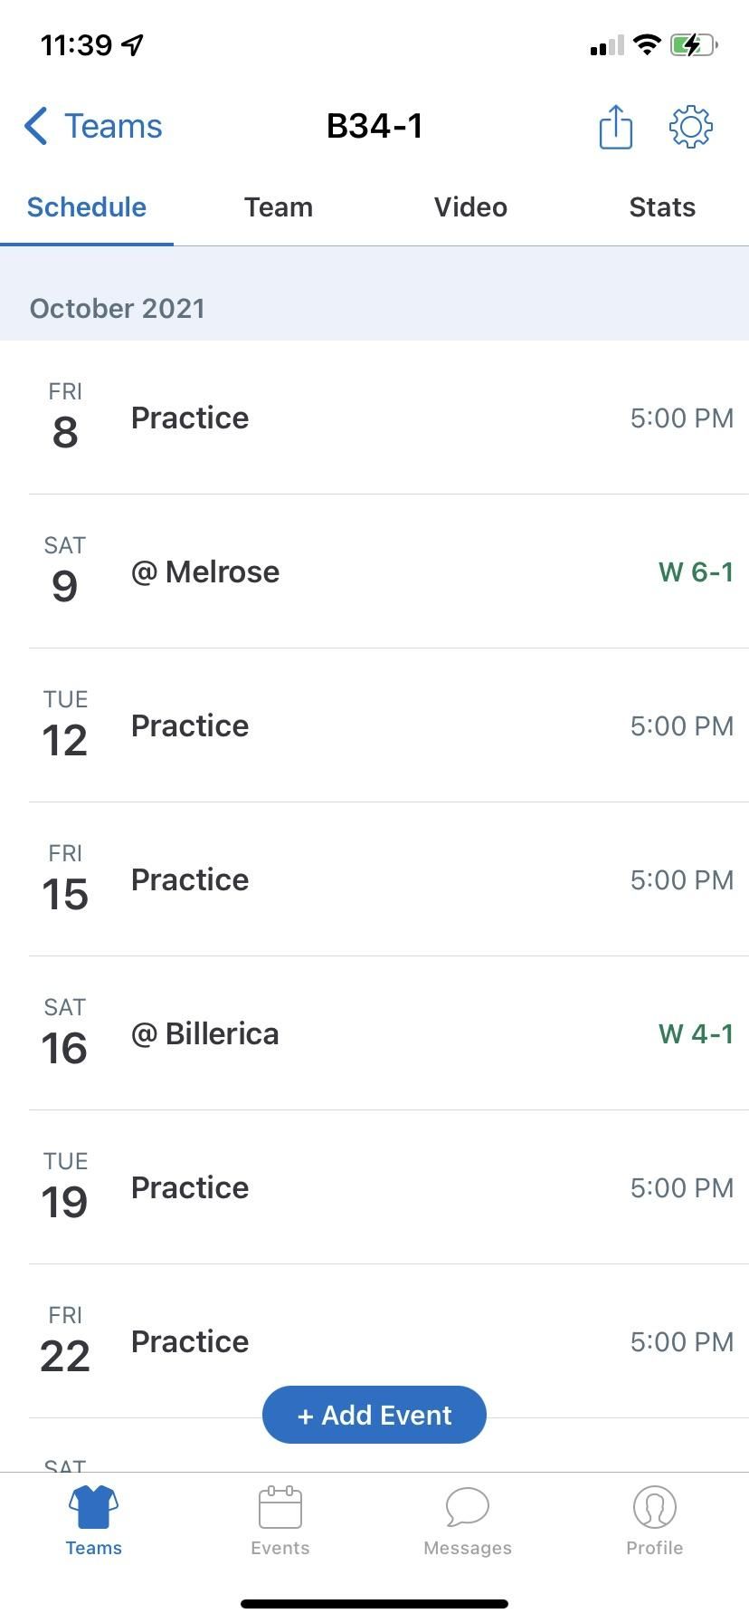
GameChanger App
What’s Good
Messaging
RSVPs (are your kids making it to practice and/to making it to the game)
Schedule (kind of a pain to load manually, but once in there, it is great, because they can RSVP to specific practices or games)
What’s NOT Good
Integration to the web page. So for example if someone changes their email address or contact info, etc. it won’t end up in the app. If the schedule changes with MYSL, you have to change it manually.

Slide 37
Questions / Comments ?
Thank you!!!
&
Thank you for coaching!!!

Slide 38
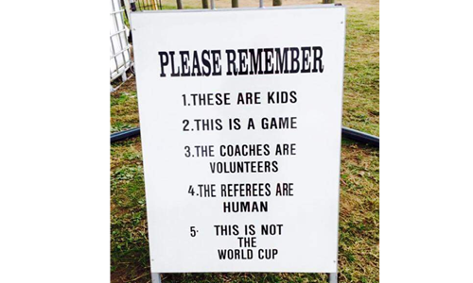
CYSA – Key Take Away

Slide 39
Appendix

Slide 40
MYSL Player Pass Process: 1
Please read the complete – MYSL player pass process, Pages 20-23
Highlights & Key Points - Start process early in week
Player’s own team takes priority
Player MUST play both games (both coach and player say OK)
Why Play Up? 🡪 not enough players or reward and opportunity
ONLY PLAY FOR 1 OTHER TEAM (2 GAMES MAX ON SATURDAY)
Up to 4 players playing up to 1 team for each week
A player can play up a maximum of 3 times per season for a specific team
Playing up Rules
Playing in same age group – same division or any lower division
Playing in an older age group – 1 division higher or below
Need 2 copies of MYSL roster and passcards(SPRING ONLY) for Grade 5&6 & older
Highlight player(s) playing up on the roster
Notify MYSL Registrar, MYSL Age Director & CYSA Travel Director- email – use form – see attached

Slide 41
MYSL Player Pass Process: 2
Create MYSL SportsManager Account
Go to https://www.sportsmanager.us/teamapp
If do not already have an account:
Choose login.
Enter your email address used for your coaching account.
Then choose forgot password. An email will be sent with a password.
Log in using your password.
Choose “Club Passes” on left side of screen.
Find correct game where you are using Club/Player Pass.
Choose Add Player
Select player from correct team and add them.
Select Game Date Roster and print it out to bring to game.
You will need the physical Player Passcard as well, so make sure to get it from coach/player and keep track of it to be able to return to player after the game.
Link to document with screenshots: Player Pass Instructions

Slide 42
MYSL Rescheduling Process
Managed by the Home Team Coach.
Email the away coach and suggest three dates/times. Use your practice nights.
Makeup games take priority over all practices for field use
Agree on a date/time with the away coach
For all age groups:
Email CYSA Field Assignor, Patti Goodwin (field_assignor@chelmsfordyouthsoccer.com)
Email CYSA Referee Director, Kayode Michael Arimoro (referees@chelmsfordyouthsoccer.com)
They both must approve the request (field and referee availability)
Email correct Age Director from MYSL about the rescheduling of the game. Contact info for your particular Age Director found on MYSL page and under Board/Management
Once approved by the CYSA Field Assignor and the Referee Assignor/Director – use the MYSL process email with link (sent only to the home team head coach)

Slide 43
Concussions

Slide 44
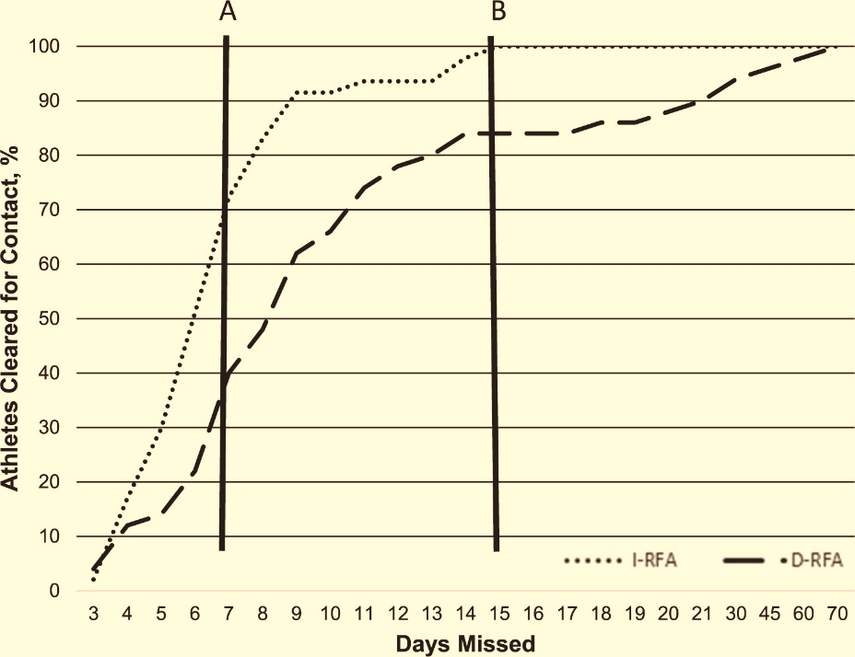
Concussions
Athletes removed immediately from play recover significantly faster than those that stay in
Immediately means immediately
Minutes make a difference
If you think you saw something, you saw something – do not take a “wait and see” approach
Breton M. Asken, MS, ATC; “Playing Through It”: Delayed Reporting and Removal From Athletic Activity After Concussion Predicts Prolonged Recovery. Journal of Athletic Training: April 2016, Vol. 51, No. 4, pp. 329-335.

Slide 45
Parent Videos – what not to do
Parent Behavior
Criticizing Referees (4 minute mark)

Slide 46
CYSA Playing Philosophy
Grades 3 through 6
All players Should have equal playing
All players Must play at least 40%
All players Should play all positions
Player Must not play keeper all game (1 half only)
All players Should play keeper
Unless player is afraid or coach concerned about injury
Why? 🡪 Player development over Winning

Slide 47
CYSA Playing Philosophy
Grades 7 and older
All players Should have equal playing
All players Must play at least 40%
Players start to focus on playing a specific position, but playing different positions is still best for their development
Keepers
Not typically all players – small group who want to play
Player Should only play Keeper for 1 half per game, but at this age there can be times when they play the full game

Slide 48
Games – Odd # of Teams
Brackets with Odd Teams (Mid week games)
No Saturday game for one of the weeks
Home team must use reschedule process – scheduled game shown is just a placeholder
Limited impact for the upcoming season
If impacted – start the rescheduling process ASAP
Gr 5 and above cannot be made up on Sundays, meaning they must be night games
Gr 3&4 can be on Sundays

Slide 49
Coach Education
Better coaches make better players
Coach training will help ensure that the kids enjoy their time on the pitch while advancing their knowledge of the game
Learning pathways
United States Soccer Federation (USSF)
Licenses: F, E, D, etc.
United Soccer Coaches (USC) [formerly NSCAA]
Diplomas: 7v7/9v9, 11v11, National, Advanced National, Goalkeeping
Conferences: MYSA Workshop; Soccer Champions Coaches' Clinics; USC Convention
CYSA will reimburse you for USSF and USC courses
Contact: training@chelmsfordyouthsoccer.com for additional advice

